Slide 1

Health Equity Assessment Tool (HEAT) Training
Developed by;
Kassie Styche, Health Inequalities Manager

Slide 2
Learning aims
Raise awareness of the critical importance health equity plays in everything we do
Provide practical tools and resources to embed health equity into your role
Demonstrate how the HEAT process fits into governance
Provide guidance on the Health Equity Assessment Tool (HEAT) and how to complete this
Recognise what matters to people in the community and how they might access and experience care differently

Slide 3
Health inequalities refer to systematic differences in health status or the distribution of health resources between different population groups. These differences arise from social conditions in which people are born, grow, live, work, and age. Health inequalities are often avoidable, unfair, and systematic, meaning that certain groups experience worse health outcomes and have increased difficulty accessing healthcare due to the systems that influence their lives
Why is addressing health inequalities so difficult?

Slide 4
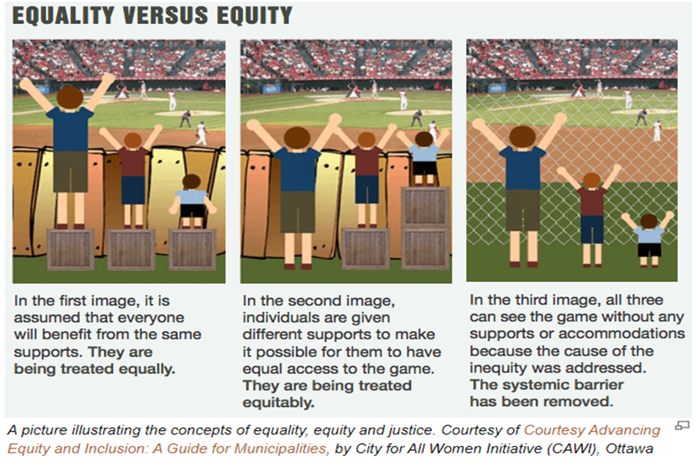
Health equity and health equality do not mean the same thing.
What is the difference?

Slide 5
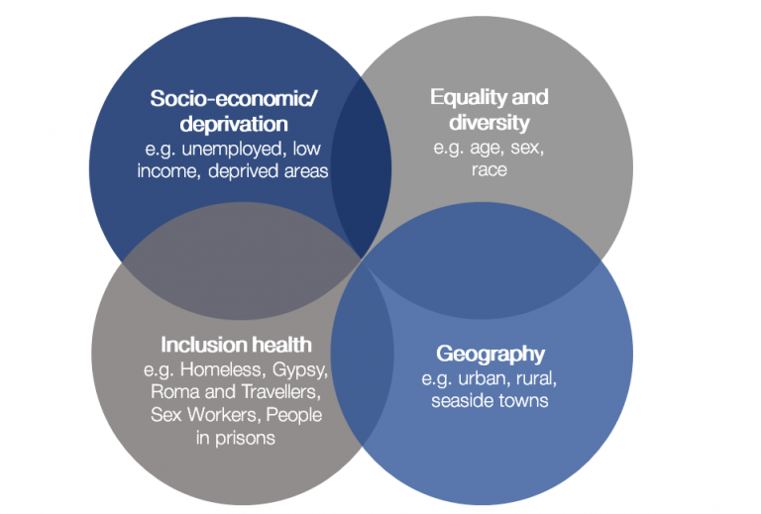
Overlapping dimensions
Notes:
This diagram outlines the overlapping dimensions of health inequalities. It illustrates that a wide array of groups in our population are at greater risk of experiencing health inequalities.
Access to care etc will be higher than if they have one of the dimensions
These characteristics are legally protected from discrimination and can be key factors in health inequalities.
Age
Disability
Gender reassignment
Marriage and civil partnership
Pregnancy and maternity
Race
Religion or belief
Sex
Sexual orientation

Slide 6

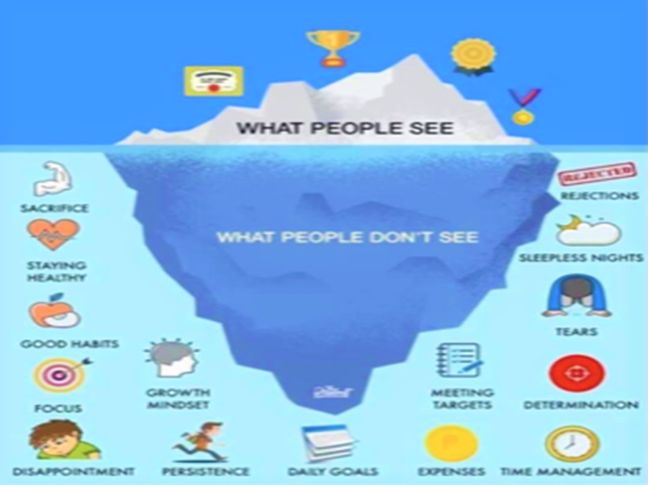

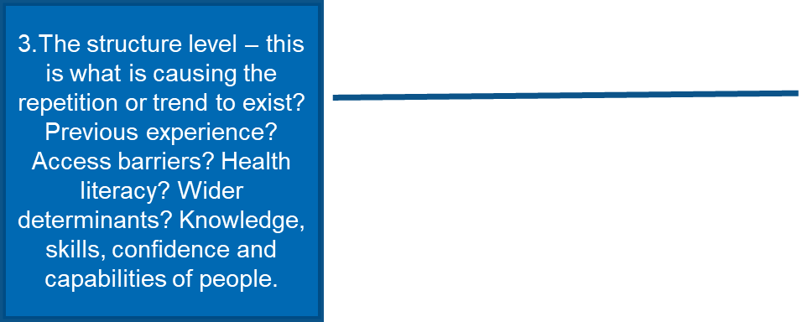

The Iceberg Model of System Thinking
By understanding people’s values, beliefs and principles (mental model level) we can begin to understand how they feel (structure level), why there are trends in behaviour (pattern level) and how this leads to events or inequalities. To explore deep below the surface, we need to have inclusive conversations.
Inclusive conversations will enable true authenticity

Slide 7
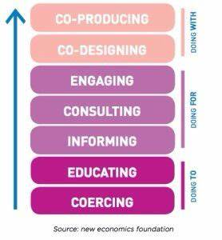
Co-design and co-production
What makes co-design and co-production successful?

Slide 8
People that use or access services have a wealth of knowledge through lived experience.
Involving those with lived experience from the very beginning of the process can develop relationships and strengthen the ethos that they are a valued part of decisions
It’s doing with, in an equal partnership
It’s health equity in action as you are giving people power and resources to initiate change!

Slide 9
Success factors
Start with people. Begin developing relationships with people from the very start and create a vision together
Strive to have an even balance of people using services and professionals.
Continually develop new relationships
Don’t just invite people ‘in’ , but get out into spaces where they go about their daily lives,
Think about outcomes and developing shared outcomes. Talking about outcomes from the start helps to move away from ‘services’ and gets people thinking about and discussing change
Changing the professional methods that are used in commissioning is just as important than changing service specifications. Appreciative enquiry, coaching, and creative forms of facilitation are key skills teams and central to the way we work.
Avoid perfectionism - its ok to make mistakes as that’s where we collectively learn and add value
Develop evidence that matters to people
Embrace this as a culture and behaviour change approach, which needs time to grow
Ensure that governance facilitate effective co-production so that it becomes a valued ‘business as usual’ approach. Don’t stifle innovation
leaders must champion this approach as a vehicle for delivering real public service
Recognise people as assets, build on people’s existing capabilities

Slide 10
Health Equity Tool
Health Equity Assessment Tool (HEAT) developed by Public Health England (PHE) to enable professionals and communities to systematically identify and address health inequalities and equity in their work programmes or services
“The tool can be used in a variety of contexts. This could include completing a health equity assessment for a new service or to assess and address specific inequalities issues associated with a change in service delivery. The tool can also be used in the context of policy change or for programme wide assessments.
It is considered best practice for a HEAT to be started at the beginning of when a problem or opportunity for improvement is being framed. A HEAT should be done
When policy change is being considered
Before commissioning and implementing a new service
Before planning rounds commence and programmes are being worked up (e.g., strategic, and operational planning)”
When starting new projects or programmes of work

Slide 11
Governance of the HEAT Tool
Start HEAT at start up or project / programme of work
Co-produce from start - don’t do HEAT in isolation
Embed this as part of your continuous PMO approach and cycle. (PIDs/Business case/plans/Risk logs etc).
HEAT is submitted to your decision making groups
Make a standard requirement that without HEAT, proposal cannot proceed
Make it a fixed agenda item for all project steering groups to review actions
Review regularly
When reviewing your HEAT consider:
  Has anything changed which impacts population? (Framing of problem, project/service, population needs, risks/issues?)
  Have the actions been fulfilled?

Slide 12
Support and resources
Health Equity Assessment Tool (HEAT) | https://www.gov.uk/government/publications/health-equity-assessment-tool-heat
NHSE | https://digital.nhs.uk/data-and-information/data-collections-and-data-sets/data-sets
Kings fund research | https://www.kingsfund.org.uk/
Public Health England data | https://fingertips.phe.org.uk/
GP national profiles | National General Practice Profiles - Data - PHE
Advisory Board resource library | https://www.advisory.com/topics/health-equity
Review Prioritise
Level of support
Agree a review date

Slide 13
Support and resources
Resources and e-learning to support systematic action on health inequalities and equalities. | https://www.gov.uk/government/publications/health-equity-assessment-tool-heat
Personalised care and population health A framework of evidence to guide professionals in preventing illness, protecting health and promoting wellbeing. | https://www.gov.uk/government/collections/all-our-health-personalised-care-and-population-health
UK Health Inequalities Blog | https://ukhsa.blog.gov.uk/category/priority2/health-inequalities-priority2/
Place based approaches to reduce health equalities | https://www.gov.uk/government/publications/health-inequalities-place-based-approaches-to-reduce-inequalities
Review Prioritise
Level of support
Agree a review date

Slide 14
Support and resources
Health Inequalities Improvement Dashboard | https://www.england.nhs.uk/about/equality/equality-hub/national-healthcare-inequalities-improvement-programme/data-and-insight/hi-improvement-dashboard/
To help guide your thinking on what inequalities mean for populations | https://ageing-better.org.uk/publications/ageing-inequality-ethnicity-evidence-cards
Equality Act 2010 | Equality Act 2010: guidance - GOV.UK
Working in partnership with people and communities: Statutory guidance | https://www.england.nhs.uk/long-read/working-in-partnership-with-people-and-communities-statutory-guidance/
Review Prioritise
Level of support
Agree a review date

