Slide 1
BLACK HEALTH EQUITY STRATEGY
Prostate Cancer UK

Slide 2
EXECUTIVE SUMMARY
This strategy outlines how Prostate Cancer UK’s Black Health Equity work….

Slide 3
DISCOVERY

Slide 4
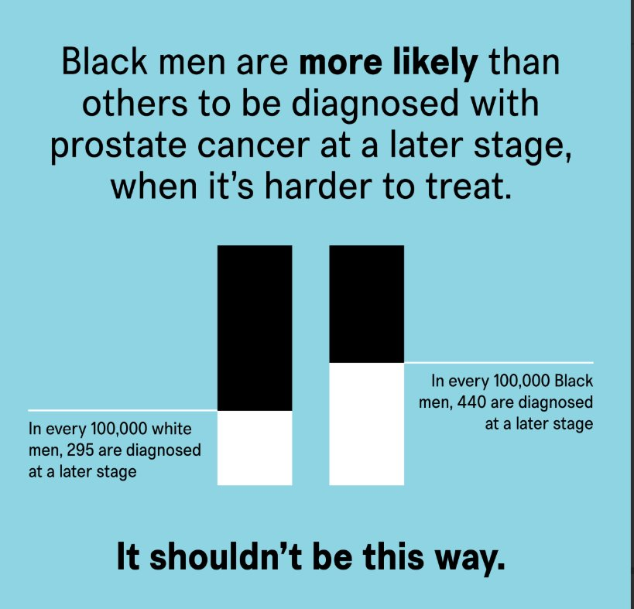
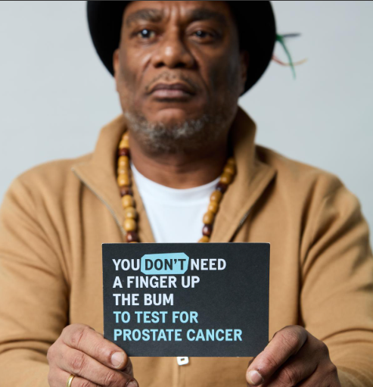
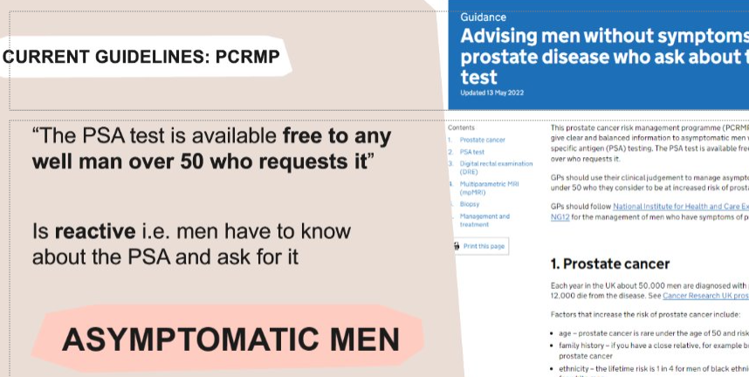
Diagnostic pathway – systemic barriers to early diagnosis
There is a lack of information and knowledge about prostate cancer amongst Black men, including lack of information about family history of prostate and breast cancer.
For many, this is combined with a hesitancy to engage with medical profession and diagnosis, with previous negative experiences being an important barrier.
Medical practitioners are not always aware of elevated risks for Black men.
There is a lack of awareness of rights (eg to a PSA test) and inconsistencies in application of guidance – e.g. instances of being refused PSA test.
Prostate Cancer UK has made good progress in awareness-raising activities in Black communities but limited in capacity and largely London-focused.
1 in 4 Black men will get prostate cancer in their lifetime
Twice the risk of dying
Black men likely to develop prostate cancer at a young age
NO TARGETED SCREENING PROGRAMME
Experience of the health care system varied
Some Black men will experience additional barriers to diagnosis – e.g. those with NRPF, men not registered with GP, with language barriers, or those who are digitally excluded.
Notes:
In some cases, religious or cultural expectations and belief relating to health can be barriers to engagement.

Slide 5
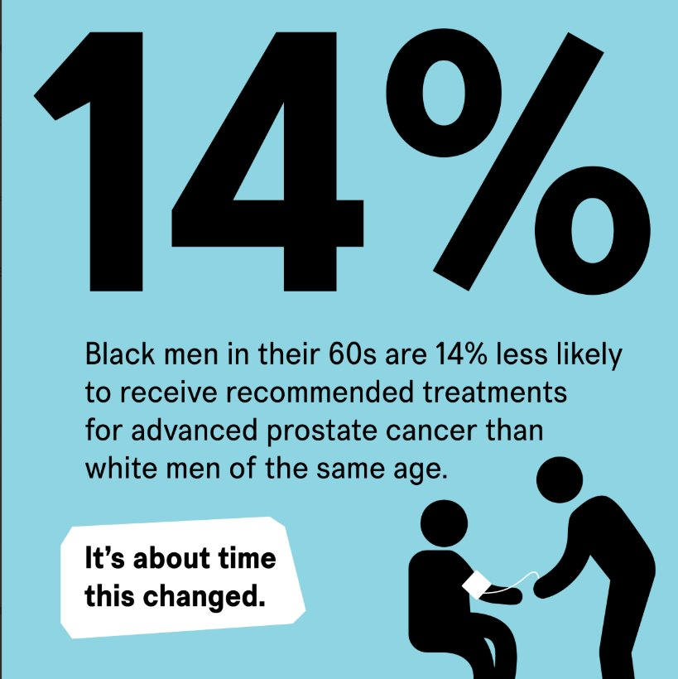
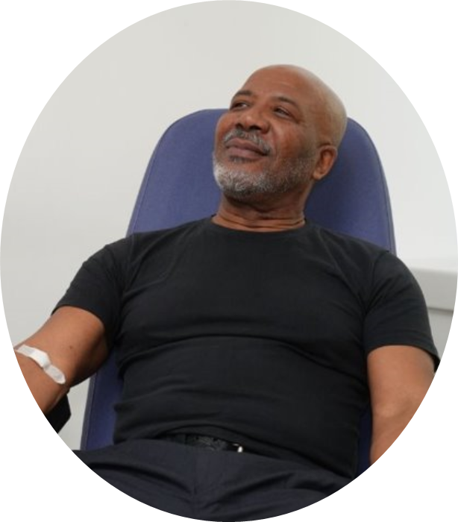

TREATMENT PATHWAY – SIGNIFICANT TREATMENT DISPARITIES
Black men’s access to treatment and research trials is variable and differs by area.
There are instances when men navigating prostate cancer have shared information about clinical trials with those who would not otherwise have been aware of them, highlighting the inconsistent access and lack of communication on what is available.
The evidence base is not strong enough on the differences in treatment responses for Black men.
Concerns about impact on work may affect treatment decisions; more needs to be done to highlight how working age men may be impacted.
More research is needed to understand lack of treatment parity
Nearly 1 in 4 (23%) ethnic minority adults reported that they did not trust pharmaceutical companies to test treatments and devices on them. This was highest among Black/African/Caribbean adults (29%). Ispos 2024
Lack of diversity within clinical research community
Notes:
Black men in their 60s who get a later diagnosis are 14% less likely to receive NICE-approved treatments.
Black men less likely to receive radical treatment for high risk/ locally advanced disease than other men.
Black men underrepresented in research populations and most treatments are not developed with Black men.

Slide 6
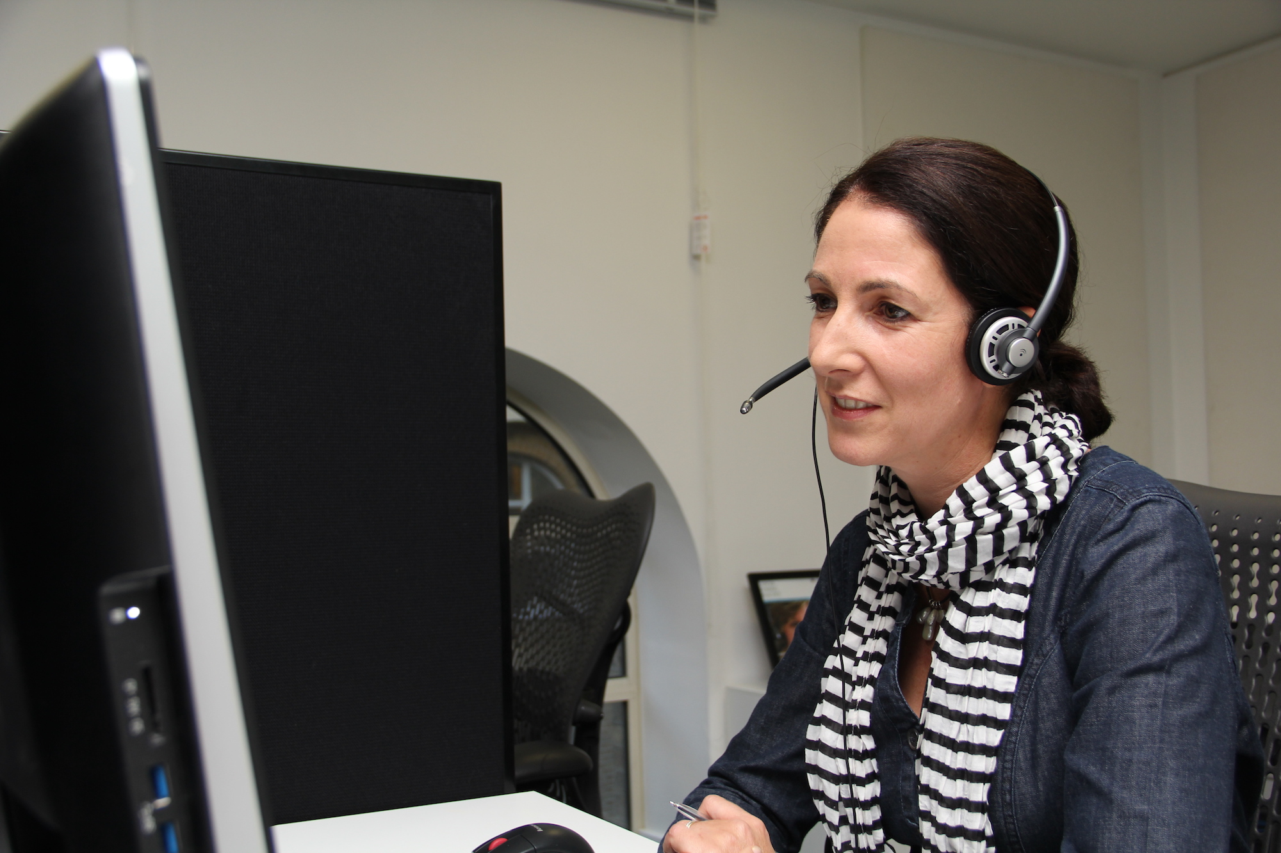
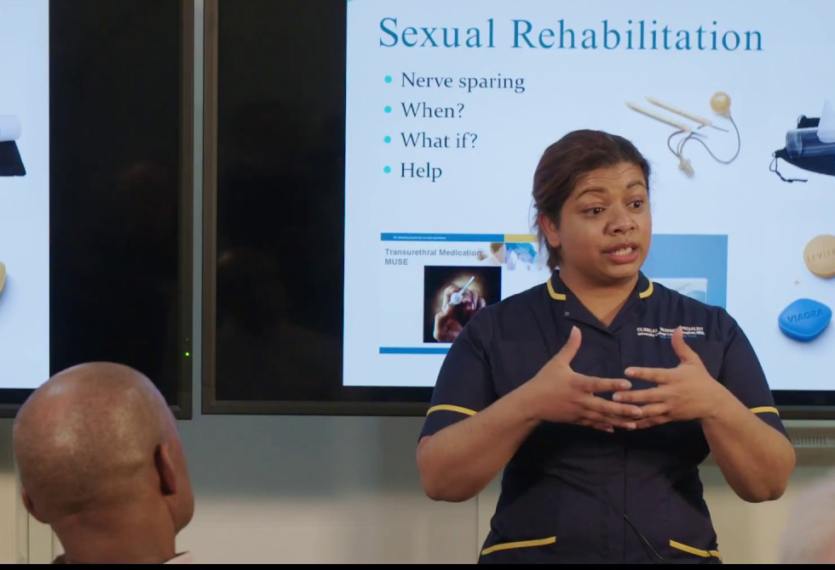
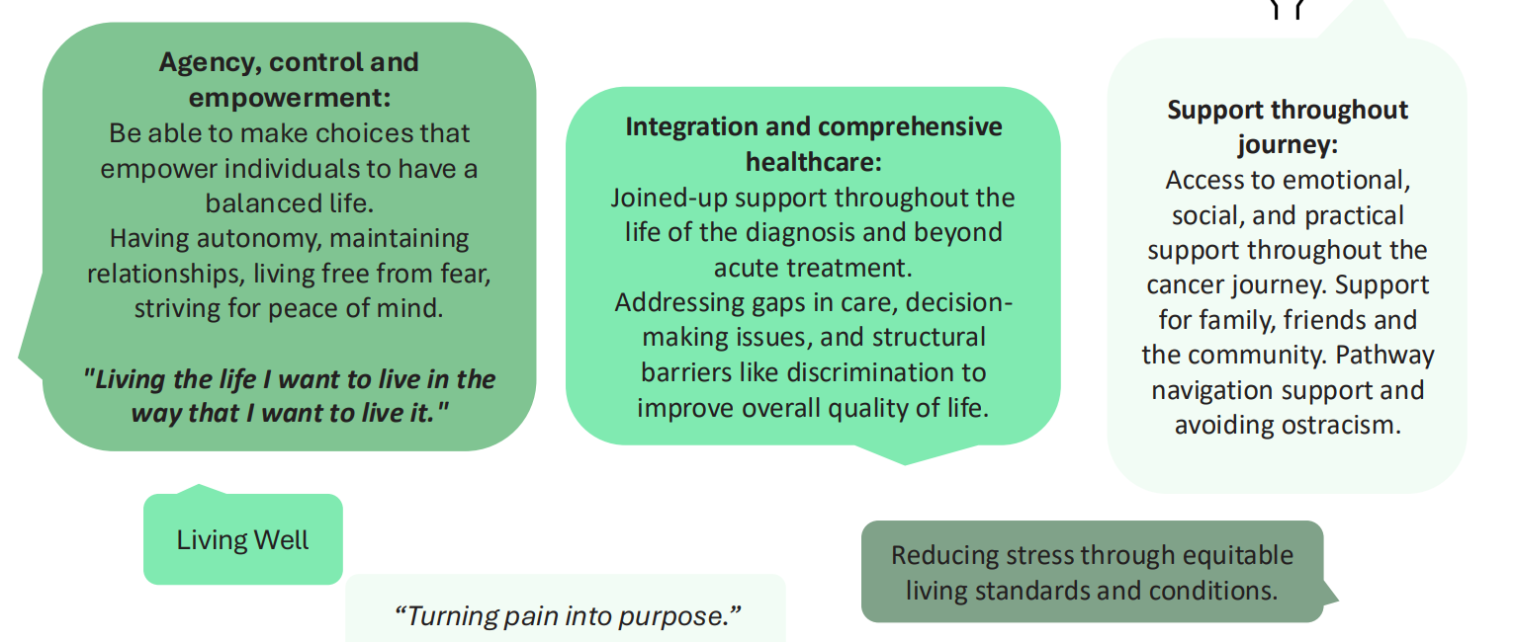
Support PATHWAY – personalised experience of care
Early diagnosis is important, but support for men living with prostate cancer is also vital.
Support needs to be culturally appropriate and relevant to Black men – connecting with Black men with lived and shared experiences who can share information about e.g. changes to their body and impact on relationships is important.
Support needs to respond to the diversity of experiences of Black men with prostate cancer – spaces need to be psychologically safe for members of the LBTQI community for example, and Prostate Cancer UK’s partnerships and ambassadors should uphold the inclusive ethos of the organisation.
There are lots of local organisations with a strong reach into Black communities providing support across the country
Lack of accurate data about Black men using specialist nurse service, but thought to be as low as c. 4% currently
Historical lack of trust in the organisation means that Prostate Cancer UK’s specialist nurse service is not currently well used by Black men
Macmillan Cancer Support Survey

Slide 7
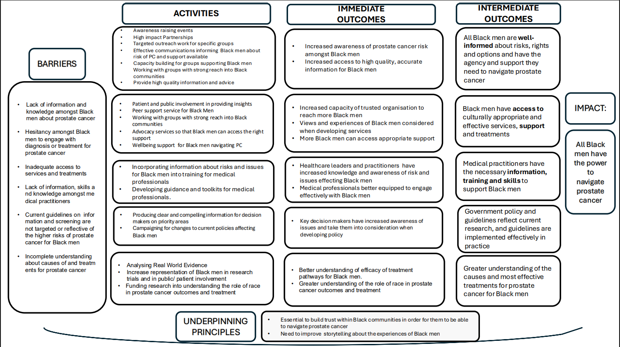

Slide 8
Black Health Equity strategy
Our Missions
Risk, Rights, Options

Slide 9
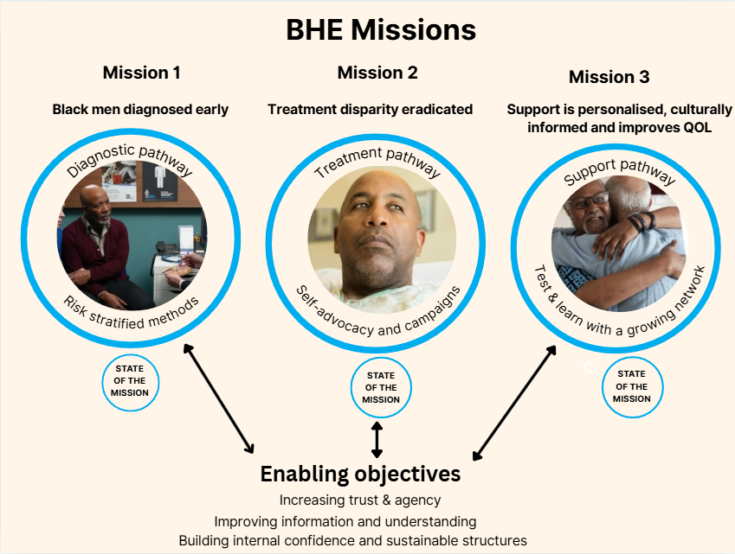

Slide 10
Mission 1 – Black men diagnosed early
New Activities
Launch the Black Health Equity National Network
Embed a new approach to optimising national targeted outreach work – raising awareness of health inequities in prostate cancer, starting with Black men
Introduce a pilot model of delivery that encompasses the processes, methods and strategies that effectively and efficiently dismantle systemic barriers to equitable outcomes for Black men.
Proliferate in priority regions a model of delivery that encompasses the processes, methods and strategies that effectively and efficiently dismantle systemic barriers to equitable outcomes for Black men
Develop a new microsite for Black Health Equity - informed by the ‘Black experience’ and the needs of Black communities
Enhanced BAU
Campaign for the introduction of an Early Detection Programme, including changing PCRMP rules allowing GPs to proactively talk with men most at risk of prostate cancer, including Black men
Extend and expand our risk awareness work through strengthened partnerships and effective collaboration
Invest in high impact partnerships with the voluntary community sector, health equity activists and community leaders.
Produce high quality and effective health information materials including, physical resources to raise awareness and provide advice and guidance - informed by the ‘Black experience’ and bespoke to the needs of Black communities

Slide 11
Mission 1 – Black men diagnosed early
New Activities
Establish a Black health equity working group with the Black Parliamentary Caucus to influence key policy priorities set out in Faster. Fairer. Better
Embed a new approach using the Prostate Cancer UK Risk checker and Risk Information Service to lead more Black men, 45 years+ to enquire about PSA blood test
Develop a corporate partnership and strategic collaboration plan to raise our profile as legitimate advocates in Black health equity
Develop a Black Health Equity Volunteer Recruitment Programme to grow our pool of volunteers supporting our national targeted outreach work
Foster a global community of real-world data analysts working at the intersection of health equity and prostate cancer
Enhanced BAU
Influence local practice & local pathways by incorporating risk, rights, and options for Black men into our education programme for health care professionals
Number of Black men doing Prostate Cancer UK’s risk checker remains above 10% of Black men at risk reached/yr NB: there are 360k Black men aged 45-70 in the UK
Increase representation of Black men in PPI decision-making process and PPI involvement in clinical research
Conduct in-house data analysis to uncover and measure inequalities in prostate cancer diagnosis and treatment, and provide insights into prostate cancer trends for Black men in the UK

Slide 12
Mission 2 – Treatment disparity eradicated
New Activities
Establish a working group to engage with the NHS Trusts most commonly treating Black men with prostate cancer to develop a pilot model that understands then dismantles barriers to treatment parity for Black men
Develop an internally built tool that supports men with treatment choice decision making informed by the 'Black experience'
Introduce a treatment buddy programme for Black men starting their treatment journey co-developed with the Black Peer Support Steering group
Increase our understanding of clinical practice for Black men utilising data from NPCA, Get Data Out^
Enhanced BAU
Produce high quality and effective health information materials about treatment options including, physical resources - informed by the ‘Black experience’ and bespoke to the needs of Black communities
Influence local practice & local pathways by incorporating risk, rights, and options for Black men into our education programme for health care professionals
Increase representation of Black men in PPI decision-making process and PPI involvement in clinical research
Share our research in prostate cancer and Black men with the research community through peer-reviewed journals, meetings, and conferences
Campaign for increased diversity in prostate cancer research community, starting with existing and prospective Prostate Cancer UK grant holders

Slide 13
Mission 3 - Support is personalised, culturally informed and improves quality of life
New Activities
Support the development and delivery of a bespoke peer-to-peer support service for Black men with prostate cancer
Develop an end-to-end visualisation and critical review of a Black men’s journey through our in-house and commissioned support services
Support the EAU Diversity in Prostate Cancer PROMs study and subsequent findings to shape legislation, clinical guidelines and influence how healthcare providers deliver care.
Support the piloting of a sexual wellbeing prehabilitation service for men referred for prostate cancer treatment – ensuring that it is informed by the ‘Black experience’
Enhanced BAU
Optimise data capture on ethnicity of service users thereby reducing % of 'unknown'
Grow the % of callers with self-recorded Black ethnicity accessing our specialist nurse service
Produce high quality and effective health information materials on support services including, physical resources - informed by the ‘Black experience’ and bespoke to the needs of Black communities
Grow the number of Black men that participate in our programmes that combine information, group support and goal-setting following prostate cancer treatment.
Embed the practice of incorporating the views and experiences of Black men and Black communities during service conception, development, and performance review

Slide 14
What does winning look like?
Mission 1: Black men diagnosed early​
More Black men diagnosed at stage 1 and 2
Increase in number of Black men using the risk checker
Increase in % of Black men calling Risk Information Service
Increase in number of Black men and communities receiving risk awareness information
Increased understanding within clinical community of Black health inequity in prostate cancer
Policy changes made so that GP guidelines encourage proactive conversations with asymptomatic men at highest risk
Mission 2: Treatment disparity eradicated​
A - Understanding and tackling treatment disparity:
Increased understanding within clinical community of treatment disparity for Black men
B Greater awareness of treatment options:
More Black men report feeling supported in making an informed decision about their treatment choice
Increase in number of Black men using Prostate Cancer UK tools and information about treatment options open to them
Increase in number of Black men accessing treatment buddy services in NHS Trusts most commonly treatment Black men
C Increased understanding of how Black men are affected by prostate cancer/ treatment efficacy:
Growing research community focusing on Black health equity in prostate cancer
Increase in % of Black men participating in PPI
Increase diversity of prostate cancer researchers
Mission 3:Support is personalised, culturally informed and improves quality of life​
​Increase in number of Black men calling the Prostate Cancer UK specialist nurse service
Increase in number of Black men using Prostate Cancer UK’s support services – both delivered and commissioned
More Black men report feeling prostate cancer support services are culturally sensitive, personalised and improves their quality of life
Notes:
To discuss with Keith:
Mission 1:
Is it more at stages 1 and 2 or fewer at 3 and 4? How many more – % of population or % of those diagnosed?
Highlighted sections are key activities in Keith’s updated slides but don’t currently have a specific target. I think they should be included if they are a key part of the strategic activity for this mission.
Mission 2:
Is it informed decision about treatment or fewer reporting treatment regret?
Looking through activity slides for mission 2, they can be grouped into the 3 areas outlined above. I’ve highlighted those that need more specific targets
Mission 3:
- Highlighted sections are highlighted as activities in slides.

Slide 15
Mission 1 – New Activities Milestones
2025 - 2030 | Yr1 | Yr2 | Yr3 | Yr4 | Yr5
Activity 1 | Launch the Black Health Equity National Network
Activity 2 |  | Embed a new approach to optimising national targeted outreach work
Activity 3 | Introduce a pilot model of delivery
Activity 4 | Develop a new microsite for Black Health Equity
Activity 5 |  | Proliferate in priority regions a model of delivery
Activity 6 |  | Establish a Black health equity working group with the Black Parliamentary Caucus

Slide 16
Mission 1 – New Activities Milestones
2025 - 2030 | Yr1 | Yr2 | Yr3 | Yr4 | Yr5
Activity 7 |  | Embed a new approach using the Prostate Cancer UK Risk checker and Risk Information Service
Activity 8 | Develop a corporate partnership and strategic collaboration plan
Activity 9 |  | Develop a Black Health Equity Volunteer Recruitment Programme
Activity 10 |  |  | Foster a global community of real-world data researchers

Slide 17
Mission 2 - New Activities Milestones
2025-2030 | Yr1 | Yr2 | Yr3 | Yr4 | Yr5
Activity 1 |  |  | Develop a pilot model that dismantles barriers to treatment parity for Black men
Activity 2 |  | Internally built tool that supports men with treatment choice decision making
Activity 3 |  | Introduce a treatment buddy programme for Black men
Activity 4 |  | Increase our understanding of clinical practice for Black men utilising data from NPCA, Get Data Out^

Slide 18
Mission 3 – New Activities Milestones
2025-2030 | Yr1 | Yr2 | Yr3 | Yr4 | Yr5
Activity 1 | Support the development and delivery of a bespoke peer-to-peer support service
Activity 2 |  | End-to-end visualisation and critical review of a Black men’s journey through our support services
Activity 3 |  |  | Support the EAU Diversity in Prostate Cancer PROMs study and subsequent findings
Activity 4 |  | Support the piloting of a sexual wellbeing prehabilitation service

Slide 19
Black Health
Equity strategy
Our Enabling objectives

Slide 20
Black Health Equity and Positive Change
Context
Our mission is to support men to navigate prostate cancer, so no man is left behind.
We know that not all men have the same risk of prostate cancer – Black men face double the risk.
To deliver impact for the communities we serve, we need to be an organisation that thrives on diverse thinking and inclusion -recognising differences in ethnicity, cultural and socially relevant needs ,
Understanding and endorsing our Black health equity work is a key area of impact and an essential part of our roles for all current and future colleagues.
​
​
What does this mean for us?
We need to confidently and clearly explain why and how we’re reducing health and structural inequalities for Black men and their communities.
We must be ambassadors for positive change,
not only driving a broad inclusion agenda but also where we proactively challenge racism and are recognised by Black communities as legitimate advocates and allies for their needs.
To do this, we’re on a journey to build an organisation that’s inclusive, open minded and committed to learning. Where we recognise and embrace unique experiences and perspectives.

Slide 21
Enabling objectives:
Increasing confidence, trust and agency
Improving information, willingness and understanding
Building sustainable structures within Prostate Cancer UK and the Black Health Equity Network
New Activities
Develop an external communication plan for Black Health Equity work
Develop an internal communication plan for Black Health Equity work
Introduce a narrative about the measures of success from the Black health equity programme into the organisations annual impact report
Develop a culture of race advocacy, where all colleagues understand and proactively engage in Black Health Equity work – demonstrating individual commitment to health equity and positive change in objectives
Introduce new programmes to offer Black talent opportunities to learn about our work and develop their skills. Eg The 10,000 Interns Programme
Enhanced BAU
Enhance our story telling of the ‘Black experience’ by effectively engaging with Black stakeholders and embedding both Black Health Equity Communication plans
Optimise our relationship with Black celebrity ambassadors and influencers by expanding the pool, harnessing deeper relationships, and adopting an operation plan
Provide space for meaningful and consistent engagement with Black stakeholders and community groups. The impact of our work on Black stakeholders, is considered within engagement planning and impact assessments.
Embed the Black health equity programme into the organisations measures of success
Increase the representation of Black talent at all levels across the organisation in line with the UK workforce in 2025 and exceed this in 2026/27
Explore race focused network of support for Black colleagues

Slide 22
Enabling objectives:
Increasing confidence, trust and agency
Improving information, willingness and understanding
Building sustainable structures within Prostate Cancer UK and the Black Health Equity Network
New Activities
Commit to and sign the Race at Work Charter including all seven actions – holding ourselves account for positive change
Develop and cascade educational events and insights sessions celebrating Black culture
Introduce new Black health equity and cultural competency Leadership programme to embed learning into practice
Introduce new package of support to members of the Black Health Equity Network to deliver against our Black Health Equity programme
Conduct Happiness Index Survey inclusive of anti-racist questions
Enhanced BAU
Train all colleagues to be allies to Black communities and to identify and challenge racism
Update our website to emphasise the importance of a diverse and inclusive workplace
Ensure Black colleagues have equal access to fair and transparent promotions
Ensure our onboarding experience helps new colleagues understand our Black Health Equity work and the reasons why we focus on Black men (D&E), eg Big Welcome
Embed inclusive leadership into our new leadership and management development programmes
Roll out and embed recommendations from inclusive recruitment audit, ensuring we measure and report on impact and changes

Slide 23
Enabling objectives– Milestones for New Activity
2025 - 2030 | Yr1 | Yr2 | Yr3 | Yr4 | Yr5
Activity 1 | Develop an external communication plan for Black Health Equity work
Activity 2 | Develop an internal communication plan for Black Health Equity work
Activity 3 |  | Introduce a narrative about the measures of success
Activity 4 |  | Develop a culture of race advocacy, where all colleagues understand and proactively engage
Activity 5 |  |  | Introduce new programmes to offer Black talent opportunities to learn about our work and develop their skills

Slide 24
Enabling objectives– Milestones for New Activity
2025 - 2030 | Yr1 | Yr2 | Yr3 | Yr4 | Yr5
Activity 6 | Commit to and sign the Race at Work Charter
Activity 7 |  | Develop and cascade educational events and insights sessions celebrating Black culture
Activity 8 |  | Introduce new Black health equity Leadership programme to embed learning in practise
Activity 9 |  | Introduce new package of support to members of the National Black Health Equity Network
Activity 10 |  | Conduct Happiness Index Survey inclusive of anti-racist questions

Slide 25
STRATEGIC PLANS

Slide 26
STRATEGIC PLAN:
MISSION 1
Black men diagnosed early

Slide 27
Mission 1 (the what)
Black men diagnosed early - We will apply risk stratified methods
Aim (the why) - Discovery Insight
Systemic barriers to early diagnosis
Activity (the how) | Tasks | Resources
Launch the Black Health Equity National Network | Create founding steering group to establish purpose, culture, and core leadership (governance, charter, funding plan & budget) Work with the Volunteer Experience team to ensure alignment and best practice process Conduct mapping exercise across four nations to produce list of prospective regional members Explore optimisation of existing funding arrangements with a view to match-fund Produce brand and digital presence Soft launch to position the Network in the BHE space National launch and recruitment of members | Year 1 Black Health Equity Engagement Manager x1 (28k – remaining year)* Steering group resourcing (6 months) (6k) National launch event (15k) Communication & Marketing (5k) Total: £54k *6 months remaining in year 1
Embed a new approach to optimising national targeted outreach work | Make investment Develop M&E Framework Publish Year 1 Impact Summary Secure 2nd year funding | Year 2 Black Health Equity Engagement Manager x1 (56k) Direct awards granted x 12 (144k)* Capacity Building for Members e.g. training, engagement materials, guides (20k) Total: £220k *grants of £10 - 12k per grantee
Introduce a pilot model of delivery that encompasses the processes, methods and strategies that effectively and efficiently dismantle systemic barriers to equitable outcomes for Black men. | Produce sector and stakeholder audit Synthesize data from audit to co-create gap analysis and agree recommendations Produce manifesto on saving Black men's lives in prostate cancer – mission-oriented CTA document Launch and promote manifesto Mobilize internal assets to lead on recommendations Establish equity fund to build sustainable systems and increase capacity – match funded by WMA Establish West Midlands BMHAG Evaluate pilot and submit for HSJ Innovation award | Year 1 Region Pilot coordinator x1 (56k) - 1-year fixed contract (1FT) Consultation – individual x1 (15k) Audit (18k) Manifesto – promotion (10k) Equity fund (30k)* Other costs (9k) Total: £112k *match funding from WMCA (30k) - total Equity fund pot (60k)

Slide 28
Mission 1 (the what)
Black men diagnosed early - We will apply risk stratified methods
Aim (the why) - Discovery Insight
Systemic barriers to early diagnosis
Activity (the how) | Tasks | Resources
Proliferate in priority regions a model of delivery that encompasses the processes, methods and strategies that effectively and efficiently dismantle systemic barriers to equitable outcomes for Black men | Identify priority regions and timeline for proliferation Establish key elements of success from pilot e.g. equity fund and roll into Black Health Equity National Network Organisational buy-in to the proliferation plan, including establishing shared objectives across HSEI, Comms, and Fundraising and clarity on internal ownership | Year 2 Pilot report (5k) Consultation (5k) Total: £10k
Develop a new microsite for Black Health Equity - informed by the ‘Black experience’ and the needs of Black communities | Outline already exists – pages, high level content Engage with Comms BP to assess resource Finalise detail design Development & Testing Launch site | Year 1 No cost associated with this
Establish a Black health equity working group with the Black Parliamentary Caucus to influence key policy priorities set out in Faster. Fairer. Better | Develop USP - targets missions etc Identify Interacting with MPs that have interest in inequalities and health disparity Through MHP reach out to warm steak holders and develop new stakeholder network Identify champion MP Current scope - Westminster Separate question on devolved nations | Year 2 10k for parliament event + 10k contingency (£20k) APPG - £3k Plus 1 headcount - senior health officer - £48k

Slide 29
Mission 1 (the what)
Black men diagnosed early - We will apply risk stratified methods
Aim (the why) - Discovery Insight
Systemic barriers to early diagnosis
Activity (the how) | Tasks | Resources
7. Embed a new approach using the Prostate Cancer UK Risk checker and Risk Information Service to lead more Black men, 45 years+ to enquire about PSA blood test | Introduce new data set exploring the impact of Risk Information Service information in the Risk Checker* Measure impact of new data set against ethnicity Measure impact of new data set on number of Black users of the Risk Information Service Test and learn Risk Information Service information earlier in the Risk Checker flowchart for Black men Measure impact of change on number of Black users of the Risk Information Service. *Risk Information Service in Risk Checker introduced in June 2025 | None
8. Develop a corporate partnership and strategic collaboration plan to raise our profile as legitimate advocates in Black health equity | Employ dedicated Corporate Partnerships resource Partnerships team to work with Keith for brief on MI Media Focus groups with Black men with lived experience Gap analysis, evaluation and data insights to identify key sectors where partnerships can be made Create approach & proposition aligned with BHE team | New Corporate Partnerships Manager (Perm.) Year 1: approx. 14K (3 months) Year 2: approx. 56K (ongoing) MI Media Costs Year 1: Year 2:
9. Develop a Black Health Equity Volunteer Recruitment Programme to grow our pool of volunteers supporting our national targeted outreach work | Recruit Volunteer Experience Officer Introduce annual target and review (year 1 – 20 London and West Midlands; year 2 – 40 across 8 regions; year 3 – 80 across 8 regions; year 4 – 120 across 12 regions incl. devolved nations. Incorporate Black health messaging in community volunteer training modules | Year 1: New Volunteer Experience Officer (1 year - fixed - 28K) Recruitment and training expenses (5K in existing budget) Year 2: Recruitment and training expenses (30K) Year 3: Recruitment and training expenses (30K)

Slide 30
Mission 1 (the what)
Black men diagnosed early - We will apply risk stratified methods
Aim (the why) - Discovery Insight
Systemic barriers to early diagnosis
Activity (the how) | Tasks | Resources
10. Foster a global community of real-world data analysts working at the intersection of health equity and prostate cancer | Decision on key questions, specific aims and scale Currently, this will be centred on bringing a group of up to 10 researchers on a quarterly basis, focusing on genetic risk and other risk factors associated with diagnosis of aggressive prostate cancer disease in Black men. 2. Bringing experts together from around the world to: A) Share their research insights and take part in virtual events B) Research gaps, questions and expert recommendations | Year 1 Meetings and Outputs Virtual event cost including VAT Year 2 Meeting and Outputs Expert recommendations – policy document & or non-systematic review (including VAT) Estimate for meeting and meeting output costs: 10K/year Year 1-2 D&E event coordinator Part time two year fixed rate working across mission 1 and 2- £27,300 for 2 years (+20% staffing costs = £5460) in line with pay policy = £32,760 Estimate for meeting and meeting output costs: 10K Total for year 1-2: £20K + £32.76K = £52.76K

Slide 31
STRATEGIC PLAN:
MISSION 2
Treatment disparity eradicated

Slide 32
Mission 2 (the what)
Treatment disparity eradicated – We will support self-advocacy and campaign for treatment parity
Aim (the why) - Discovery Insight
Significant treatment disparities
Activity (the how) | Tasks | Resources
Establish a Black health equity working group to work with the NHS Trusts most commonly treating Black men with prostate cancer to develop a pilot model that dismantles barriers to treatment parity for Black men | Year 1 Establish a Black health equity working group of up to 10 members comprised of NPCA team, researchers (including qualitative), clinicians and nurses Focus of group: to reduce barriers to radical treatment for Black men with high risk, locally advanced prostate cancer disease Examine other treatment disparities for patients with non-metastatic disease Year 2-4 Commission mixed methods model/patient journey map required to identify causes treatment disparity across treatment pathway with questions aimed at both clinicians and patients to examine role of biases and how this informs decision making conversations. This should be combined with data based on stage and grade data plus CPG1/2/3/4/5 | Year 1 –2 Meetings; including travel and costs Year 2 – 4 Meeting and outputs Looking at about £57k over 2 years (30-40k for research) Extra role of coordinator maybe part time (£27K) Then pilot model costs - based on west midlands pilot costings
2. Develop an internally built tool that supports men with treatment choice decision making informed by the 'Black experience' |  | Year 2 Significant agency support required

Slide 33
Mission 2 (the what)
Treatment disparity eradicated – We will support self-advocacy and campaign for treatment parity
Aim (the why) - Discovery Insight
Significant treatment disparities
Activity (the how) | Tasks | Resources
3. Introduce a treatment buddy programme for Black men starting their treatment journey co-developed with the Black Peer Support Steering group | Health Improvement away day Scale the UCL model as QI Proactive engagement by HCPs – direct referrals Policy write up and innovation event Data and evidence evaluation Black Health Equity – recruitment & promotion ED – specialist conference | £30k Support costs Training Grants
4. Increase our understanding of clinical practice for Black men utilising data from NPCA, Get Data Out^ | Ongoing D&E activity Create and develop partnerships with NHS Data Ecosystem NHS data partnership application Apply to be in NHS data partner Data science investment – ISO licencing | Year 2-4 Limited – need to expand capacity NHS Partnership Fee £20k Data compliance capability – Senior officer (FGT) NHS data researchers would be 2 senior officers within NHS - not our headcount just extra costs minimum 2 year FTC

Slide 34
STRATEGIC PLAN:
MISSION 3
Support is personalised, culturally informed and improves quality of life

Slide 35
Mission 3 (the what)
Support is personalised, culturally informed and improves quality of life – We will test and learn with a growing network
Aim (the why) - Discovery Insight
Personalised experience of care
Activity (the how) | Tasks | Resources
Support the development and delivery of a bespoke peer-to-peer support service for Black men with prostate cancer | Task - recruitment of black peer support volunteers Task: Promotion & Communication. Task - develop playbook for support services - this sits above BHE. Wider piece of comms work - comms BP will help with strategy
Develop an end-to-end visualisation and critical review of a Black men’s journey through our in-house and commissioned support services | Nick
Support the EAU Diversity in Prostate Cancer PROMs study and subsequent findings to shape legislation, clinical guidelines and influence how healthcare providers deliver care. | Partnership with EAU to run study (in progress D&E analyse data Study results pushed to P&HI to be embedded in clinical guidelines | Year 3 Comms, PR Creative 10k needed for comms consultancy fees

Slide 36
Mission 3 (the what)
Support is personalised, culturally informed and improves quality of life – We will test and learn with a growing network
Aim (the why) - Discovery Insight
Personalised experience of care
Activity (the how) | Tasks | Resources
Support the piloting of a sexual wellbeing prehabilitation service for men referred for prostate cancer treatment – ensuring that it is informed by the ‘Black experience’ | Pilot launch in April in Lincolnsire. Rolling out over 2/3 years to trusts | Year 2-4 Covered by Movember. Restricted reserves for this work. Capacity / Capability brought in for Pilot - 2 new roles on FTC - budget covered

Slide 37
STRATEGIC PLAN:
Enabling objectives
Increasing confidence, trust and agency
Improving information, willingness and understanding
Building sustainable structures within Prostate Cancer UK and the Black Health Equity Network

Slide 38
Enabling objectives (the what)
We will increase internal confidence, trust and agency; Improve information, willingness and understanding; Build sustainable structures within Prostate Cancer UK and the Black Health Equity Network
Aim (the why) - Discovery Insight
We must be ambassadors for positive change
Activity (the how) | Tasks | Resources
Develop an external communication plan for Black Health Equity work |  | Year 1
Develop an internal communication plan for Black Health Equity work |  | Year 1
Introduce a narrative about the measures of success from the Black health equity programme into the organisations annual impact report |  | Year 2

Slide 39
Enabling objectives (the what)
We will increase internal confidence, trust and agency; Improve information, willingness and understanding; Build sustainable structures within Prostate Cancer UK and the Black Health Equity Network
Aim (the why) - Discovery Insight
We must be ambassadors for positive change
Activity (the how) | Tasks | Resources
Develop a culture of race advocacy, where all colleagues understand and proactively engage in Black Health Equity work | Introduce new structure of accountability incorporating Black health equity programme Continue to train colleagues to act and identify as allies – Helps colleagues better understand and advocate for communities we serve Organizing periodic Positive change and BHE updates too org, similar to Insights Week, Introduce Equality, Impact Assessment (EQIA) Training – to ensure colleagues consider the impacts of our workstreams and decisions, on Black men and their communities. | Year 2 Black health equity Programme Manager (47k) Time and commitment from BHE side with the above, eg collaborating during Black History Month and Black Inclusion Week For EQIA Training – additional support with delivering training internally would be beneficial. Currently only have Head of EDI and Head of People Experience delivering training – additional facilitator for £50,000 from BHE budget would be helpful, but not urgent.
Introduce new programmes to offer Black talent opportunities to learn about our work and develop their skills. Eg The 10,000 Interns Programme | Made a three-year commitment to 10,000 Interns covering 24,25, and 26. Final year applications going in Nov 25 – commitment to higher number of interns – 10 –12 for 26 intake Review approach where additional opportunities are presented to interns, eg offer of permanent roles after programe ends Start to scope new providers to better the opportunities provided, eg apprenticeships which contribute to RAWC commitments | Year 3 Recommendations for new providers in the internship and apprenticeship space if available 25/26 interns cost £50,000 – People Ops budget For 26/27, estimated £55,000, from Ops budget, however, if including offering a 1 year FTA - role to an intern, could benefit from £30,000 input from BHE budget – would be £60,000 if offering two x 1 year contracts
Commit to and sign the Race at Work Charter (RAWC) including all seven actions – holding ourselves account for positive change | Continue monitoring progress against all seven actions – actions align with Positive Change targets, and externally showcase our commitment to race equity | Year 1 Out of EDI budget - Yearly cost of £9,000 for membership, but cannot confirm if we will renew membership in 26/27 until business planning in Q3 of 25/26

Slide 40
Enabling objectives (the what)
We will increase internal confidence, trust and agency; Improve information, willingness and understanding; Build sustainable structures within Prostate Cancer UK and the Black Health Equity Network
Aim (the why) - Discovery Insight
We must be ambassadors for positive change
Activity (the how) | Tasks | Resources
Develop and cascade educational events and insights sessions celebrating Black culture | Build upon current training and insights sessions, giving real time and real lived experience perspectives across the organisation: Black History Month 2025 Race Equality Week 2026 Black Inclusion Week 2026 | Year 2 Support from BHE in planning and delivering events Network events come out of EDI budget. Each Network has £2,000 per year £3,000 on speaker costs (high profile) from BHE budget.
Introduce new Black health equity Leadership programme to embed learning into practise | Codesign Black health equity Leadership programme expected outcomes against enabling objectives Appointment Leadership programme delivery org Ensure learning is embedded in practice through sustainable structures Create timeline of delivery and ensure linked to Positive Change objectives in D&D process | Year 2 Appoint delivery partner (80k over 2 years)
Introduce new package of support to members of the Black Health Equity Network to deliver against our Black Health Equity programme | Ensure educational events, relevant training and insight is incorporated in Black health equity National Network package of support | Year 2
Conduct Happiness Index Survey inclusive of anti-racist questions | Ensure questions permit for deeper understanding of Black experience with the charity and our commitments to health equity | Year 2

Slide 41
Coming soon…

Slide 42
Transition plan

Slide 43
KPIs

Slide 44
APPENDIX

